Slide 1


Slide 2
GSV
Global Styles Validations – Part 2

Slide 3
AGENDA
Best practices
Display names (descriptions)
Compulsory features
Dummy features/options
Related products
Third pane specifications
Auto-assigned price levels
Information screen
Limitations
Requirements for home centers
Invalid feature items
Questions & comments

Slide 4
best practices
In order to set up GSV, different information and catalog settings are required.
Some catalog modifications may be necessary to be compatible with GSV, like setting images information, reorganize Styles & Pricing hierarchy, etc.
Next we will see guidelines to prepare catalogs for GSV and information to supply for GSV setup.

Slide 5
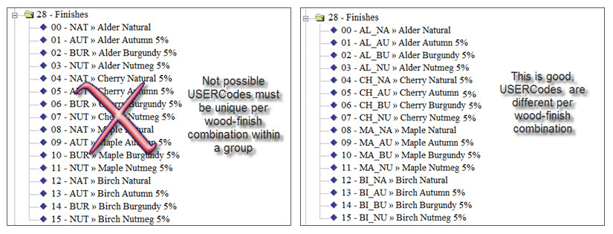
best practices
Usercodes duplicates
    The catalog must not have duplicated Usercodes within the same groups.
      I.e Upcharges 8810000-8820000-8830000-8840000, Premiums 8270000-8280000 & Hardware groups 8250000-8260000).

Slide 6
best practices
    Duplicates are usually created to be able to define a different finish texture per combination of material/specie. If you have Usercodes duplicates within the global sections and cannot modify them to be unique. you can do the following:
    Remove duplicates and modify the visual variables with expressions to switch color.
    Combined Door/Finish records
      Export globally user quantity variables (i.e.: FlexQtyxx) from the combined door style/material records to trigger visual variables to switch color;
        SQRSD-ALD - Square Raised (Alder): FlexQty50 = 1
        SQRSD-CHY - Square Raised (Cherry): FlexQty49 = 1
        SQRSD-MPL - Square Raised (Maple): FlexQty48 = 1
        SQRSD-WB - Square Raised (Birch): FlexQty47 = 1

Slide 7
best practices
    Finishes records
    This will ensure the appropriate color representation is being applied based on the door
    material/specie selected.
      Export globally VCOLxx variables on each finish to represent grain direction & material/specie + define to appropriate VISualID #.
        Vertical grain: VCOLor50 (Alder V.), VCOLor49 (Cherry V.), VCOLor48 (Maple V.), VCOLor47 (Birch V.)…
        Horizontal grain: VCOLor60 (Alder H.), VCOLor59 (Cherry H.), VCOLor58 (Maple H.), VCOLor59 (Birch H.)…
      Export globally expressions for VDoor & VDrawerFronT on the Finishes high level using the FlexQtyxx variables references.
        VDoor = Cond (FlexQty50, VCOLor50, FlexQty49, VCOLor49, ….,7024)
        VDrawerFronT = Cond (FlexQty50, VCOLor60, FlexQty49, VCOLor59, ….,7026)
      We recommend adding caption strings for the VCOLxx variables to facilitate the use of this method.

Slide 8
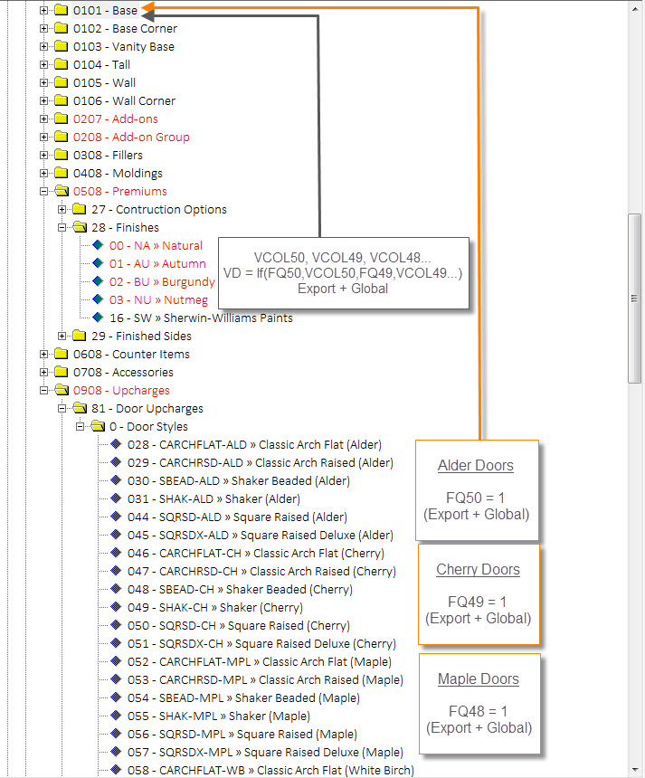
best practices
    Image showing links between Door Styles, Finishes and products to switch to appropriate VISualID # based on the material/specie selected.

Slide 9
best practices
Invalid Characters
    User codes under the Upcharges, Premiums & Hardware categories must not contain the following characters in order to ensure proper GSV function. However, these symbols can be used for the product descriptions.
        Equal symbol =
        Square brackets [ ]
        Apostrophe ‘
        Quotation marks “
Hierarchical Levels
    Structure under the Upcharges, Premiums & Hardware categories should be limited to a maximum of 2 levels to optimize GSV flow and user’s experience.

Slide 10
best practices
Descriptions
Descriptions can be modified in the 2020 catalog if possible or can also be done in the 15_Options_Upcharges.csv (please refer to slide “Display Names”);
Must not be too long and repetitive;
  Not available with….(not necessary; can be handle with restrictions, please refer to webinar session 2);
  Message included (should be done in the 3rd pane, please refer to slide “Third Pane Specifications”);
  % or price group (should be done in the 3rd pane, please refer to slide “Third Pane Specifications”).
Linkcodes, Usercodes & WhichCabCode
Make sure these variables are properly set on appropriate global styles categories (Premiums, Styles & Pricing, Hardware).

Slide 11
best practices
Option Images
    Recommended image format is .jpg or .png. Image with clear background (.png) will show the selection box color all around the image for a different visual result;
    The images will be displayed in their original dimensions. Therefore, it is important that images are provided in the correct sizes. It is recommended that the images are no larger than 150x150px. As an example, for an html page of 1325px:
      To display 3 pictures per row, width of images should be around 150px wide;
      To display 4 pictures per row, width of images should be around 110px wide;
    The images for options of the same feature must be the same size to create a better look; however, these dimensions may differ from one feature to another.
      I.e.: Door Style feature images could be 120x150 pixels and images for the Finishes feature could be 100x100 pixels.

Slide 12
best practices
Printout Text Blocks
    We suggest to put a sentence or two about the company at the top;
    We strongly recommend to add a disclaimer below the table of images:
    “Disclaimer: Images shown here are a representation of your selections,
    not an exact rendition.”
Please refer to the example on the next slide.

Slide 13
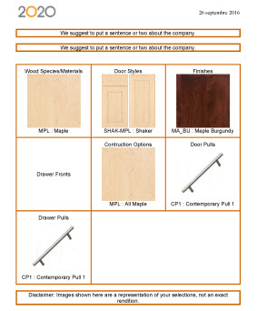
best practices
Printout text blocks example

Slide 14
display names changes
Display names (descriptions) of options in GSV are identical as listed in the catalog.
However, these names can be modified to be different in GSV especially if the 3rd pane is used to give that information (i.e. % upcharge).
Please find below an example of usage for a door style description.
  In the catalog: Shaker { Maple }
  In GSV: Shaker

Slide 15
style.css/gsvprintstyle.css
These (2) files can be modified to change the look of the GSV menu and printout.
Please note that they contain programming code. Therefore, you must be careful when making changes to not introduce malfunctions in GSV.
Below are a few examples of possible modifications.
    Text font
    Text color
    Text block background color
    Printout framing color
    Printout framing sizes
    …

Slide 16
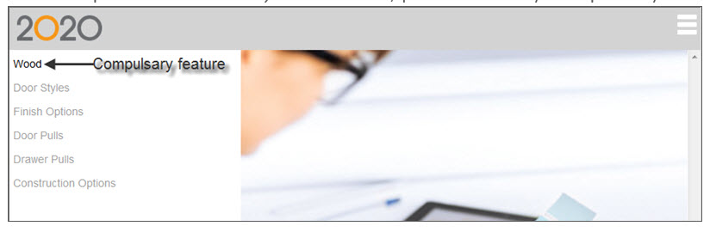
compulsory features
A compulsory feature must be specified before proceeding to other features (the other features will be greyed out until a selection is made for the compulsory features);
Multiple compulsory features can be set. However, either one of them can be set in no specific order.
Requirement for THD (Wood Species).

Slide 17
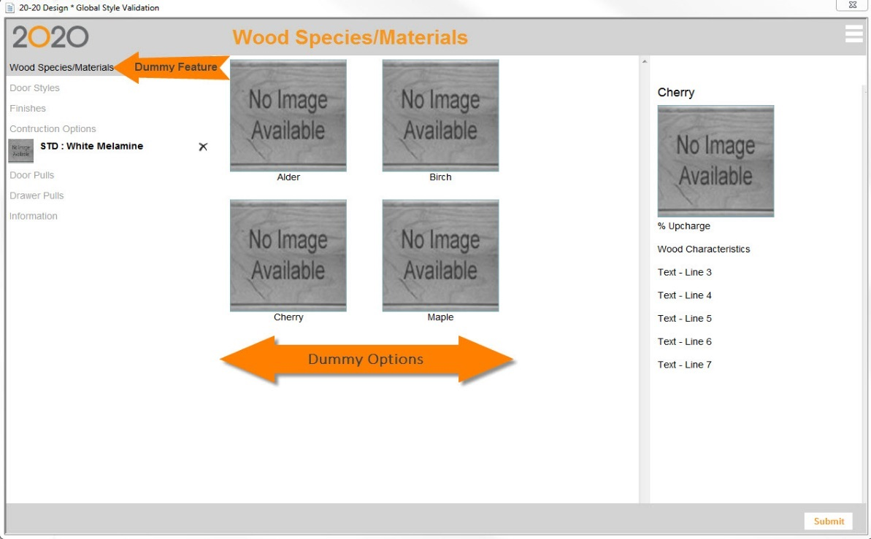
dummy features
Dummy features can be used to:
  Restraint list of available options within a group
  Reorganize features & options display
  Simplify validations with options within another group
Below are a few examples of usages:
  Materials/Species
    When this group is not listed in the 2020 catalog.
    Allows to create restrictions with door styles.
    I.e.: Materials/Species
      Cherry
      Maple
      Veneer
      Acrylic

Slide 18
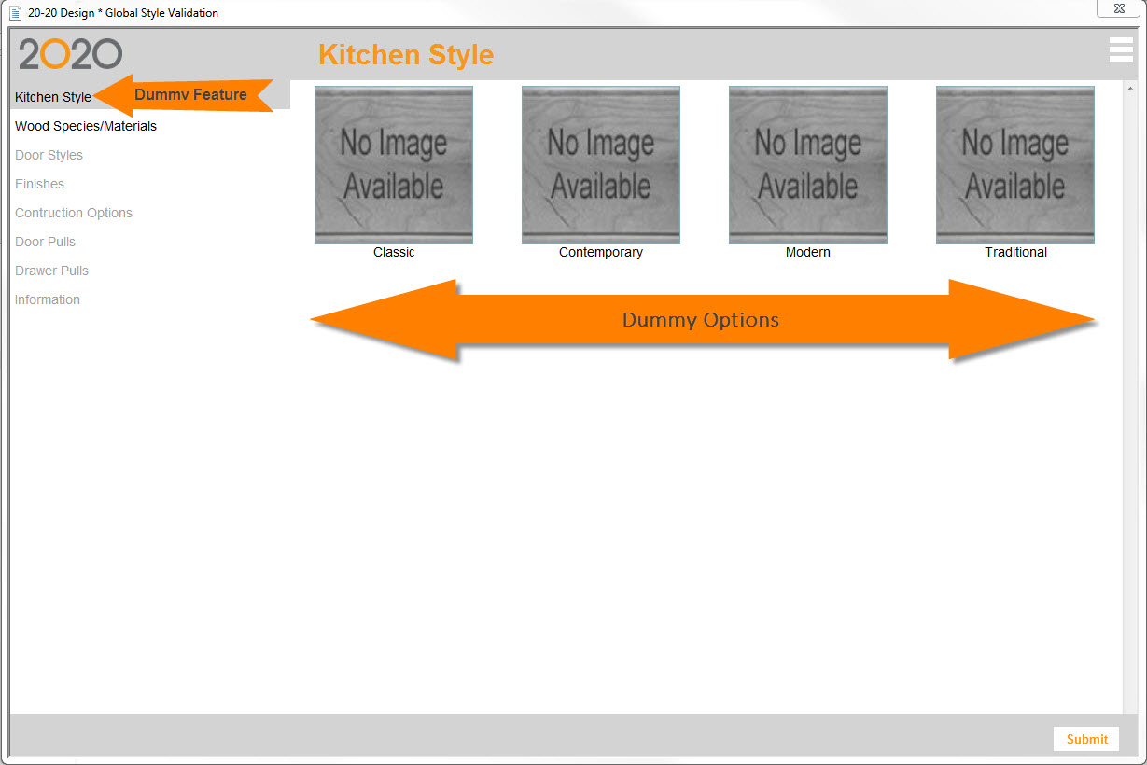
dummy features
  Kitchen Styles
    Classic
    Contemporary
    Modern
    Traditional
  Door Panels
    Flat
    Slab
    Raised
    Beaded
    Specialty

Slide 19
dummy options
Dummy options can be created to:
  Force users to make an informed choice even if a selection is not mandatory
    A dummy option can be created within a feature (i.e.: N/A, No pulls, No distressing, …)
    This way, the feature can be made mandatory to force users to make a selection. It will ensure that the users did not forget to make a choice for an optional feature.
  Restraint list of available options within a group
    This will reduce the quantity of restrictions to be created;
    I.e.: Door styles duplicated per specie/material (usually used in parallel with Related Products, please refer to slide “Related Products”).

Slide 20
dummy features/options
Selections for dummy features or options do not populate the Styles & Pricing menu with selected options as these are not “real” options.
Dummy features can be shown or not in the print report.
  Specified in the GSV “isPrintable” (FALSE) column of the 15_Options_Upcharges.csv file.

Slide 21
related products
Related products are defined in the 50_ProductsXProducts.csv file (Lookup table);
Allows to place a Styles & Pricing/Upcharge product based on options selected within other groups;
Combinations of up to three (3) options keys can control the related products;
The most common situation where related products are used is when doors are duplicated per material/specie in the 2020 catalog and features for species and doors are set as dummy features in GSV. Please find below an example.
    SHAK-CH - Shaker (Cherry) combination in the 2020 catalog;
    In GSV wood species and door styles are dummy features: CHY – Cherry and SHAK – Shaker;
    When CHY – Cherry and SHAK – Shaker options are selected, the proper 2020 catalog record is being set in Styles & Pricing: SHAK-CH.

Slide 22
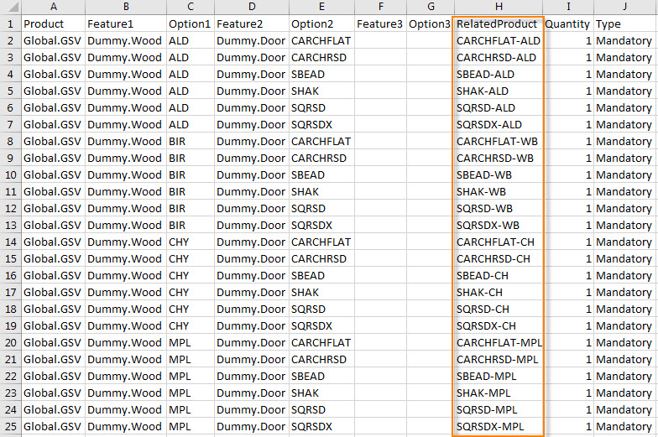
related products
50_ProductsXProducts.csv

Slide 23
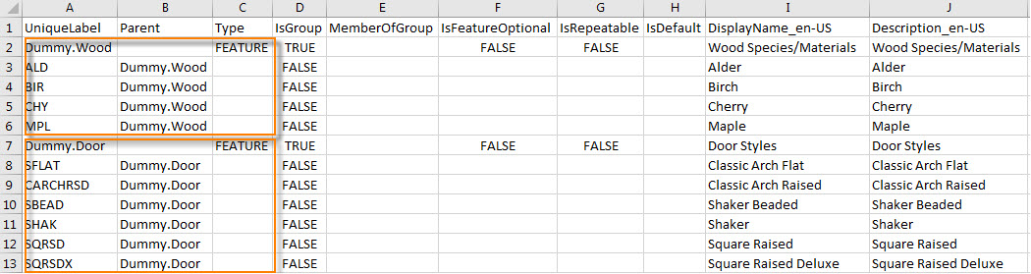
related products
15_Options_Upcharges.csv

Slide 24
third pane specifications
Additional images & specifications can be added within the 3rd column on the right side for selected features & options to improve the user experience and facilitate option selection.
  Images must be present in the MultiMedia\Pictures\Large folder and use the same name as specified in the catalog for the “medium” image using the PICture variable;
  Additional text can be set:
    In the catalog using different variables per line/paragraph. Up to (7) user text variables can be utilized. One (1) variable must be defined per line/paragraph of text (i.e. UserText1. UserText2, etc). All options having additional specifications must use the same variables OR;
    In the 15_Options_Upcharges.csv file under columns “GSV addInfo1” to “GSV addInfo7”.
    To avoid having to add the text in the 15_Options_Upcharges.csv each time 2020 regenerates the GSV spreadsheets, it is recommended to add the information in the catalog.

Slide 25
third pane specifications
  The information contained in the previous Styles & Pricing HTML pages (if applicable) can be added as images in this window.
Custom finishes and pulls can have an image displayed to provide the steps to access the 2020 Common texture library or the Common shapes library for graphical representation.
Below are a few examples of usages:
  For door styles: Edge details, overlay, construction details, pricing group
  For Species: % Upcharge, wood characteristics
  For finishes: % Upcharge, sheen, transparency details
  Box Constructions: % Upcharge, material, color, box assembly, interior & exterior specifications
  For Pulls/Knobs: Dimensions, finish, …
Keep information concise as much as possible in order not to discourage users to read all the information.

Slide 26
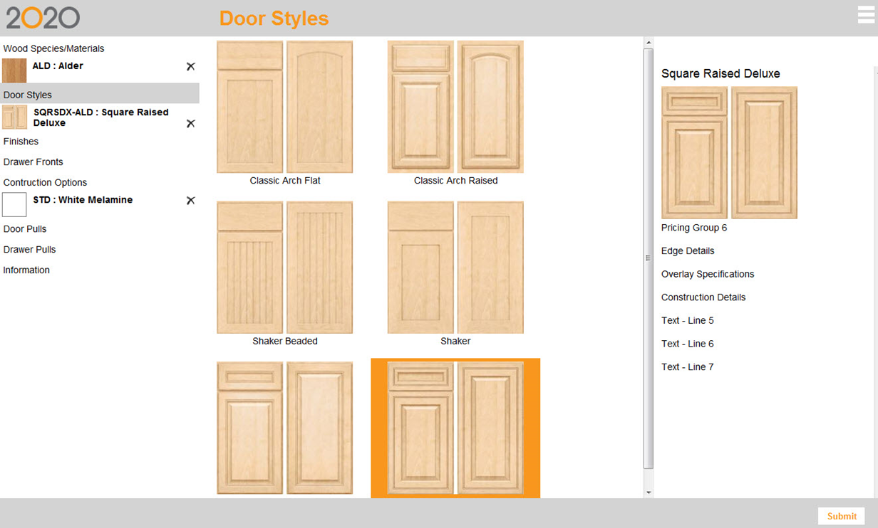
  third pane specifications
3rd Pane Specifications example

Slide 27
auto-assigned price levels
Auto-assigned price levels can be set up to expedite the process and prevent users from selecting a price level not corresponding to the options selected;
Combinations up to seven (7) options keys can control the price levels selected (i.e. Maple specie + Shaker door = Price16);
GSV can refer to PR1 to PR99 variables only; RPRxx variables can not be referenced;
For door price levels, combinations can be created:
  CSQRSD-ALD_B - Square base door in the 2020 catalog: PRice2
  CSQRSD-ALD_W - Arch wall door in the 2020 catalog: Price4
  When these two (2) door styles are selected (base door + wall door), the higher price level can be set: Price4
We strongly recommend to hide the Price Level tab under the Styles & Pricing menu so users cannot change it afterwards and it will also solve refresh issues in some versions.
  In the symfile: StylesPricingTab = 3 (Hide Price Level tab in Styles & Pricing menu)
Requirement for THD and Menards.

Slide 28
information screen
An information screen at the end of the features list can be added to guide the users for the next steps and not loop back to the first feature;
This screen can show the splash screen and an example of a printout with the options selected.
Please refer to the example on the next slide.

Slide 29
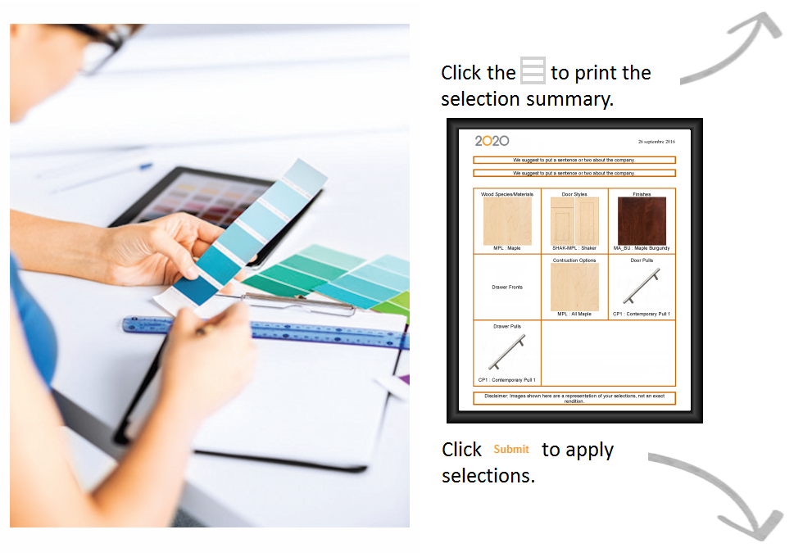
information screen

Slide 30
limitations
Refer to an external link (i.e. HTML pages or PDF documents);
Hide a main feature based on option selections within other groups;
Set a mandatory feature based on a conditional case;
Set display order of compulsory features when having more than one (1);
Set a default option based on a conditional case;
Dummy feature with a dummy sub-feature;
  Dummy feature: Material/Species
    Dummy sub-feature: Non-wood materials
      Dummy option: Thermofoil
      Dummy option: Acrylic
      …

Slide 31
limitations
Manual entry to change option code or description;
  Can be done in the Styles & Pricing menu by editing the option line.
Manual entry to select custom color, pull;
  Can be done using the Global Attributes menu after closing GSV menu.
Remove material/specie option before deleting the other options depending on it.
  Material/Specie: Maple
  Finish: Expresso ⬅ You must unselect the finish option first before removing the Material/Specie selection.

Slide 32
requirements for home centers
Menards
  Minimum of hierarchical levels
  Auto-assigned price levels
Home Depot
  Auto-assigned price levels
  Wood species compulsory feature
  All features mandatory (except for Pulls)
Lowes
  None

Slide 33
invalid feature items
Available in v11.4 + of 2020 Design;
Set variable SVQ4 in the symfile to activate the invalid items feature
Invalid items at 99999$ (five 9 to have this feature work) will display a report warning and or hatching of items on plan;
It will also open the Styles & Pricing doors dialog/html on placement of 1st item. Below are the possible values:
  101 opens Styles & Pricing (GSV) on item placement, will not do the hatching and the warning;
  102 does not open Styles & Pricing (GSV) on item placement, will do both the hatching and the warning;
  103 opens Styles & Pricing (GSV) on item placement, will do both the hatching and the warning.

Slide 34
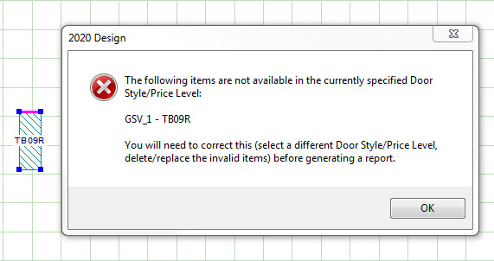
invalid feature items
The warning can stop you from accessing the report or just give a warning;
To just give a warning and allow access to the report, you can place a file at the root of the catalog;
The file name is: warningmode.dat. The file must have a content, if empty it will not be kept while shipping the catalog… Just a letter/word will work (i.e. warningmode).

Slide 35

questions & comments

